Slide 1

TECH 1004 & TECH 1004 UAC AI Technologies
AI/ML in Games
By Dr. Hu Wang, Dr. Wei Zhang

Slide 2
Astonishing AI in Game Playing

Slide 3
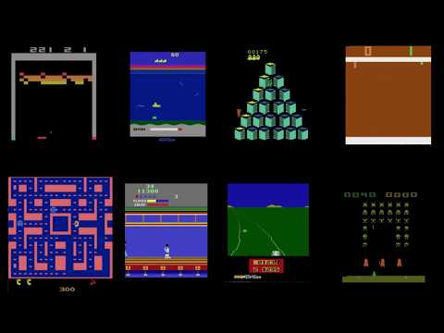
AI Game Playing --- Atari Games
https://www.youtube.com/watch?v=rQIShnTz1kU

Slide 4
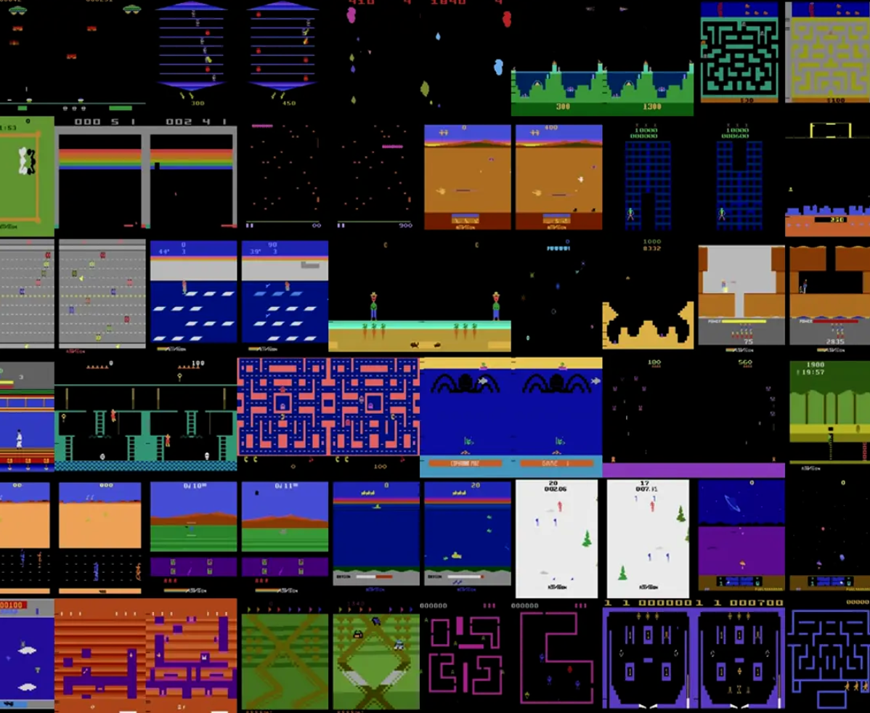
AI Game Playing --- Atari Games

Slide 5
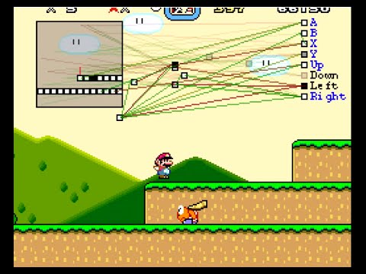
AI Game Playing --- Super Mario
https://www.youtube.com/watch?v=qv6UVOQ0F44
Notes:
Upper-left: super Mario – the red line, the positions are square boxes.
R,b,x,y,…. Controllers.
Using neural networks + evolutionary algorithms.
The node in the graph are the neurons, when the super Mario in different places, then some neurons are activated– then choose the largest one.

Slide 6
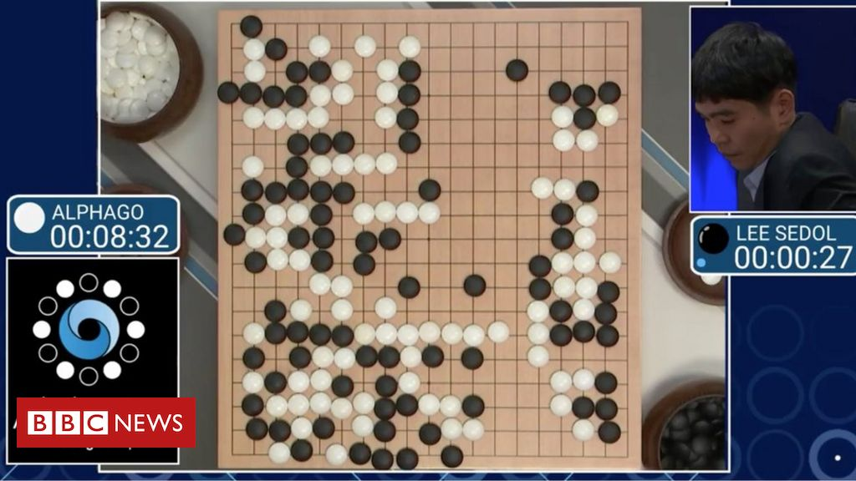
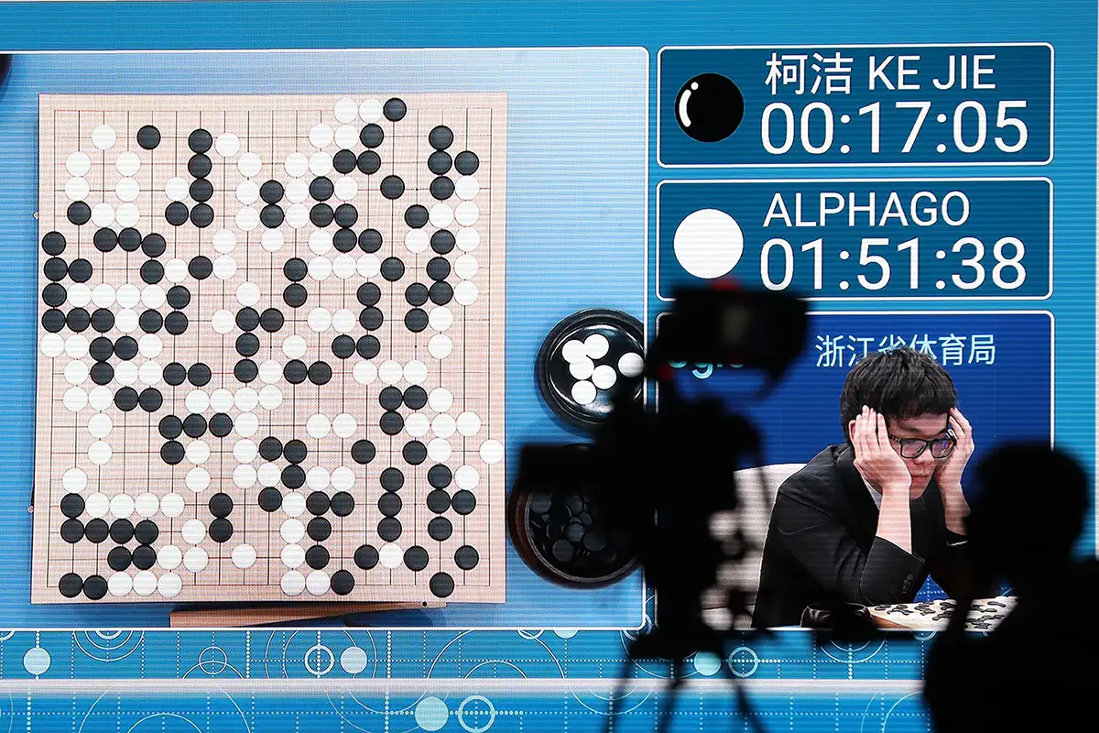
AI Game Playing --- GO
2016:
AlphaGo 4:1 Lee Sedol
2017:
AlphaGo 3:0 Ke Jie
Notes:
2016，lee sedol

Slide 7
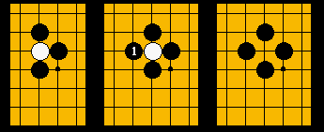
AI Game Playing --- GO
2016:
AlphaGo 4:1 Lee Sedol
GO Basic Rules:
19×19 grid of lines, containing 361 intersections.
Players take turns, places a stone on a vacant intersection on the board
Who occupies the larger area wins
If a stone is surrounded by the opponent’s stone, if will be captured/removed from the board..
Search space is too large, cannot brute force scan.
Notes:
Unlike the deep blue we introduced in the ai project lecture, that chess’s search space could be scanned via brute-force scanning, and that is how the deep blue to find the best next step.

Slide 8

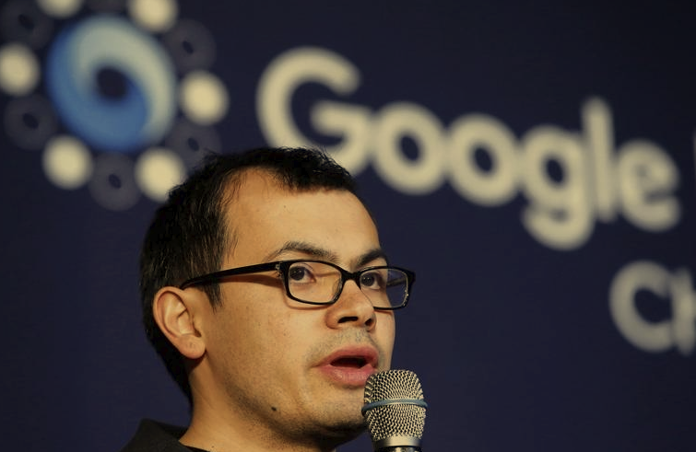
AI Game Playing --- GO
AlphaGo
By DeepMind, acquired by Google.
Reinforcement learning + supervised learning
David Silver
Demis Hassabis

Slide 9
AI Game Playing --- GO
2016:
AlphaGo 4:1 Lee Sedol
Before 78 steps, 70% win; after, the chance drop significantly --- Demis Hassabis
Move 78: When human creativity defeats the machine's computational power
The Divine Move
Demis Hassabis

Slide 10
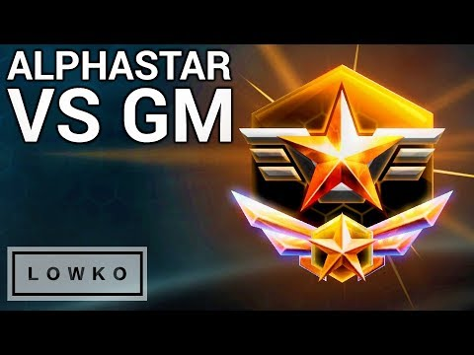
AI Game Playing --- StarCraft II
https://www.youtube.com/watch?v=VsJpWZj9jl0
Notes:
Multi-agent –many units to control , however go is single agent.
So why we wants the AI model to play games? One important usage is as the simulator. For example, a car racing game would contribute to design the system of the auto-drive car.

Slide 11
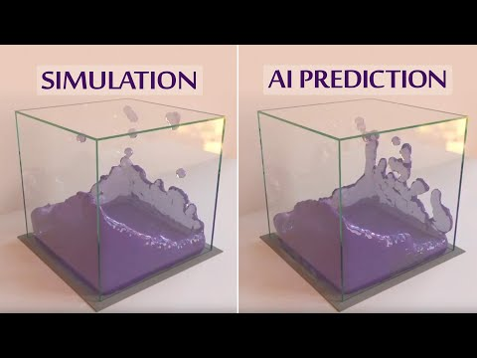
Modeling Complex Systems + More Realistic Interactions
https://www.youtube.com/watch?v=2Bw5f4vYL98

Slide 12
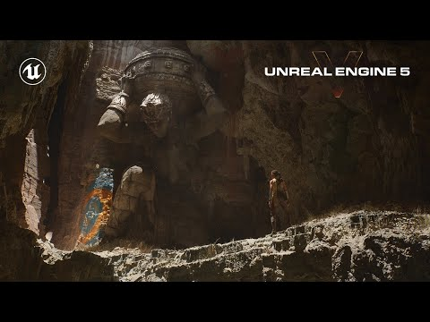
Modeling Complex Systems + Make it more beautiful
https://www.youtube.com/watch?v=qC5KtatMcUw

Slide 13
Artificial Intelligence in Gaming
Machine Learning in Game Development
Algorithms Playing as NPCs
Modeling Complex Systems
Making Games More Beautiful
More Realistic Interactions
Universe Creation on the Fly
More Engaging Mobile Games
Notes:
NPC: non-player character

Slide 14
Machine Learning revisit
Notes:
Before talking about supervised learning, we need to talke about what is machine learning first.

Slide 15
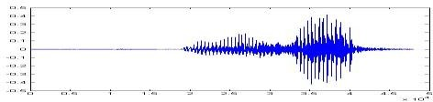

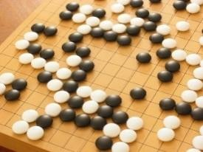
Machine Learning --- Finding Functions
Speech Recognition
f (
Image Recognition
f (
) = “How are you”
) = “Cat”
Playing Go
f (
) = “5-5”
(next move)
Dialogue System
f ( “How are you?” ) =
(what the user said)
“I am fine.”
(system response)

Slide 16

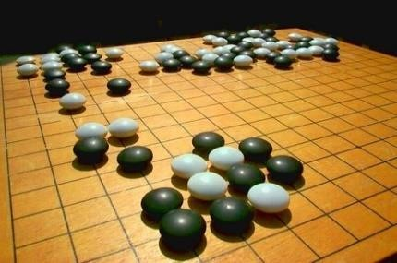
Single Step v.s. Sequential Decision
Single step decision:
“Cat”
𝑦
𝒇
𝑥
Sequential decision
First move …… many moves ……
Win!
Next move:
“5-5”
Next move:
“3-3”
Notes:
When we want to have the sequential decisions that has interactions, the supervised learning is not enough. → reinformcement learning.

Slide 17
Three Techniques
Notes:
In this course we mainly talk about two techniques

Slide 18
Game theory
Search methods
Reinforcement learning
Notes:
Before talking about supervised learning, we need to talke about what is machine learning first.

Slide 19
Game Theory

Slide 20
Game Theory --- Have a think
From 0-100, choose one interger.
WIN, if this number is less than 1/3 of average number chosen by your classmates

Slide 21
Game Theory --- Nash Equilibrium
From 0-100, choose one interger.
WIN, if this number is less than 1/3 of average number chosen by your classmates
The answer is 0!

Slide 22
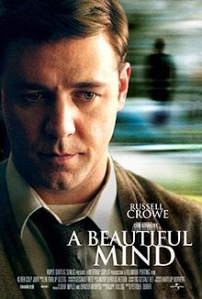
Game Theory --- Nash Equilibrium
From 0-100, choose one integer.
WIN, if this number is less than 1/3 of average number chosen by your classmates
The answer is 0!

Slide 23
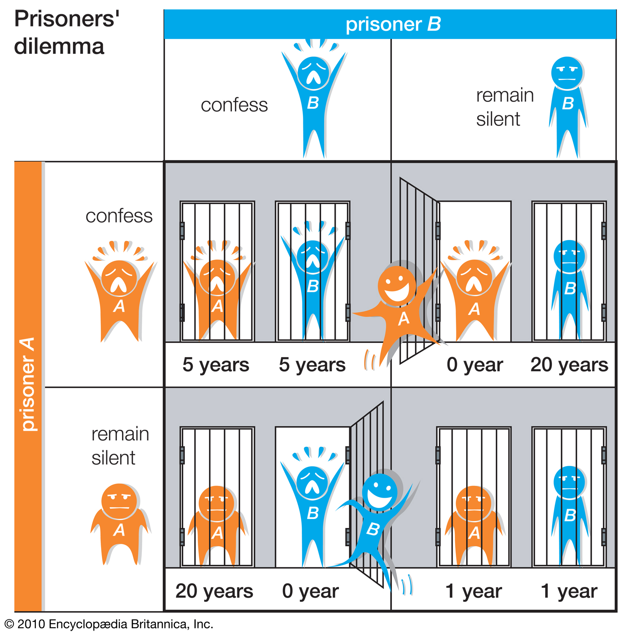
Game Theory --- Nash Equilibrium
https://www.britannica.com/science/game-theory/The-prisoners-dilemma

Slide 24
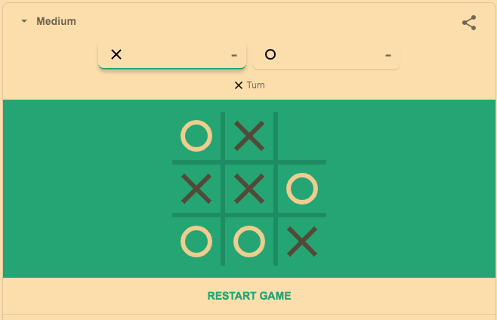
Tic Tac Toe

Slide 25
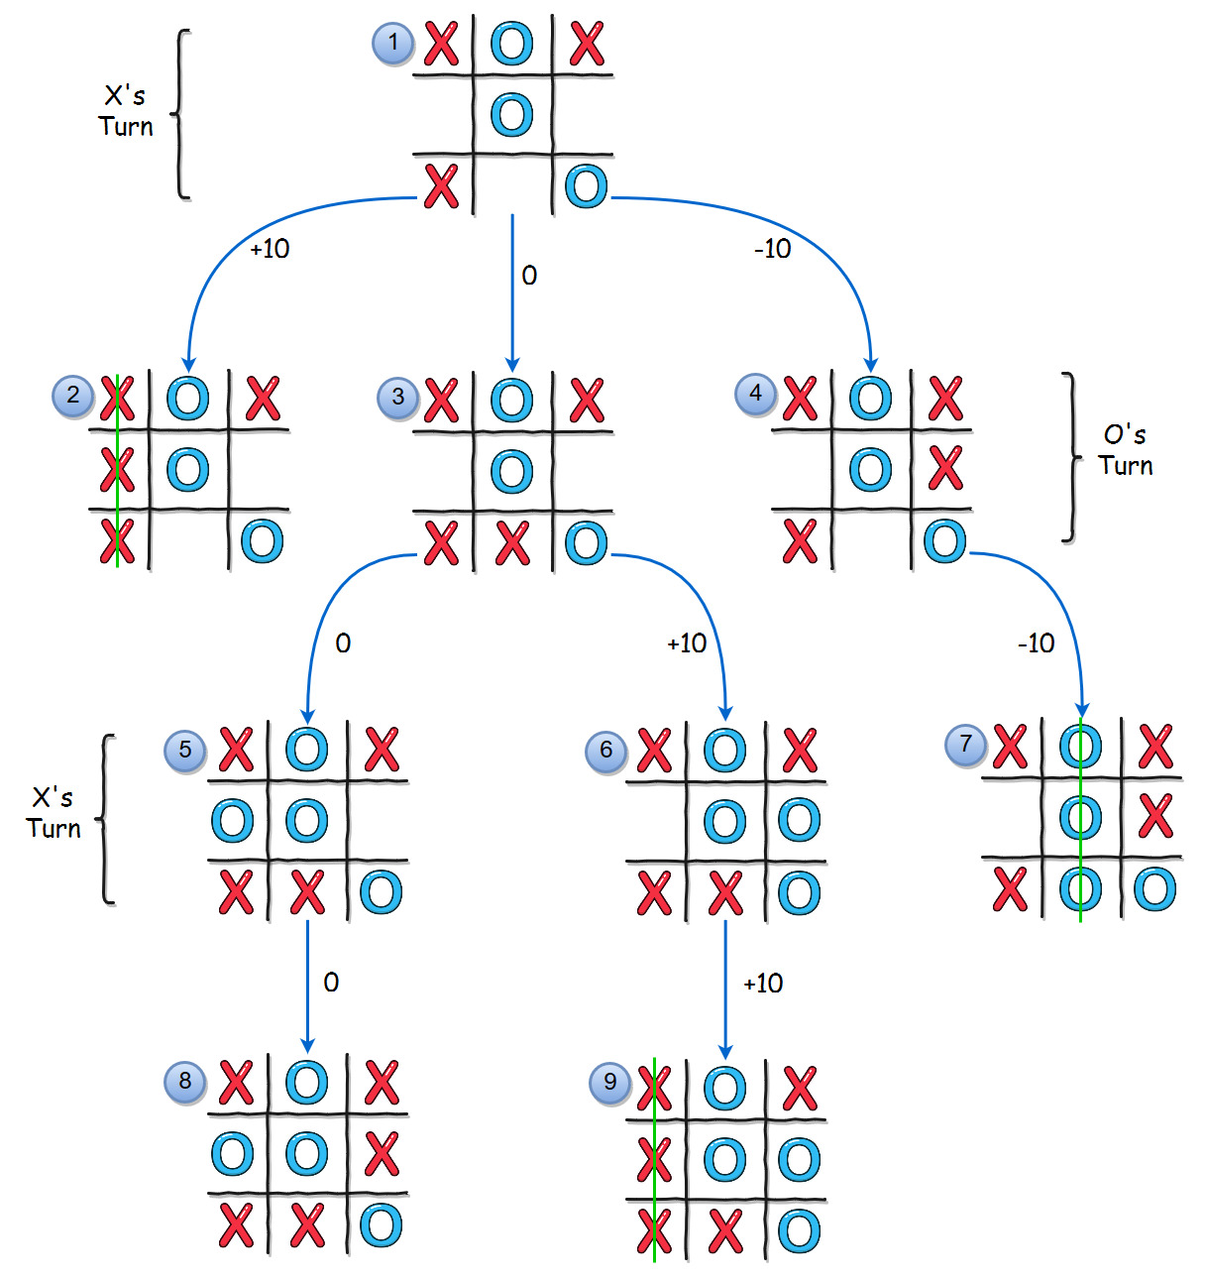
Tic Tac Toe

Slide 26
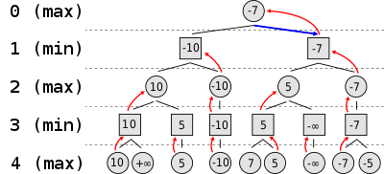
Tic Tac Toe --- Max-min

Slide 27
Search Methods

Slide 28
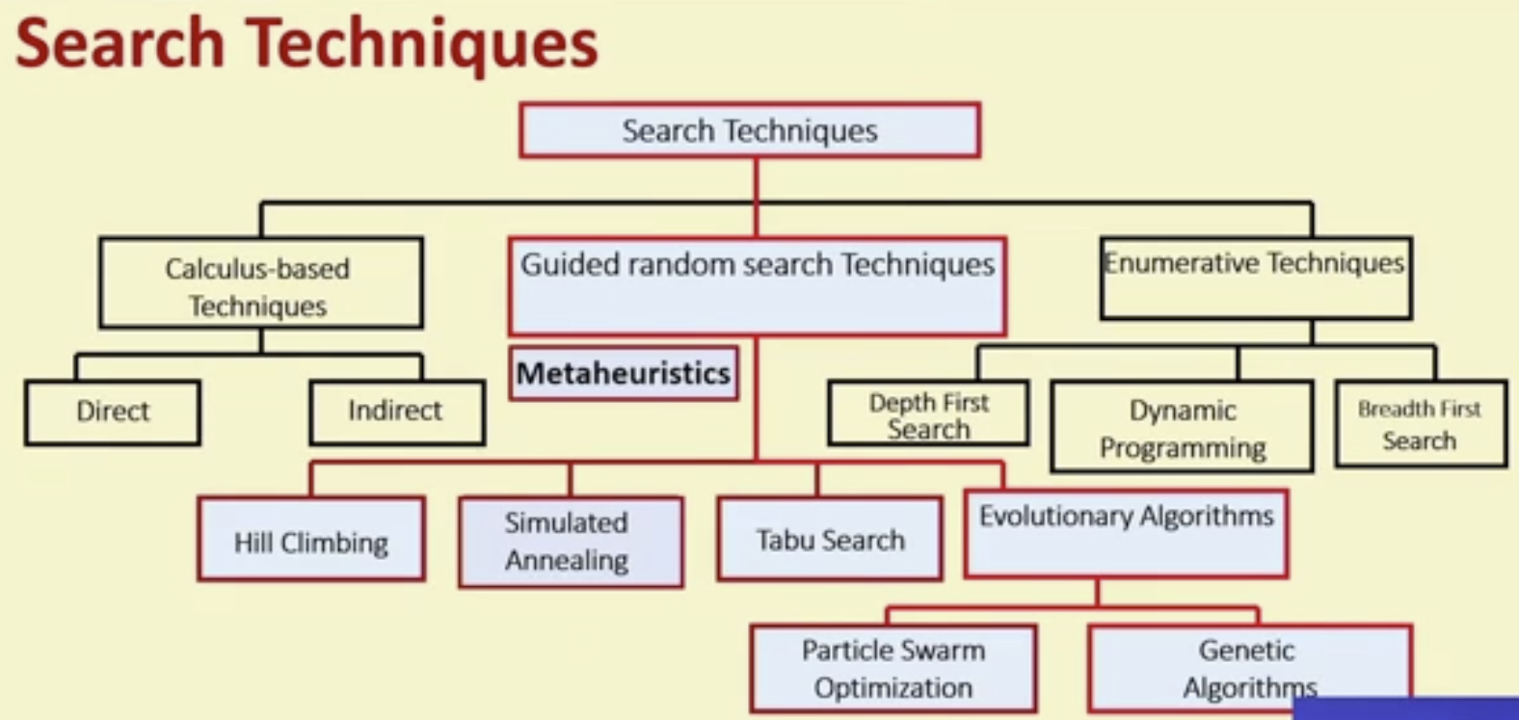

Slide 29
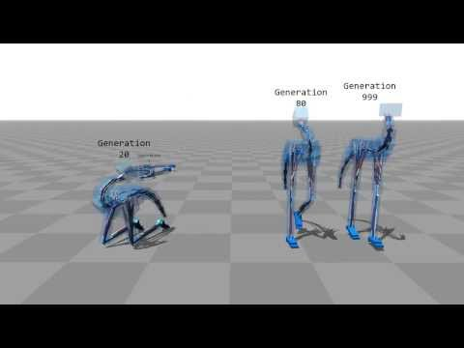
Evolutionary Algorithm --- Selection Mechanisms
https://www.youtube.com/watch?v=pgaEE27nsQw

Slide 30
Reinforcement Learning

Slide 31

Reinforcement Learning Algorithms
State: Observation of current env
Action: Reaction of an agent
Reward: return from env as an indicator
Objective: maximize cumulative reward
Similar with human: observing by eyes ---> judging by brain ---> taking actions by hands

Slide 32
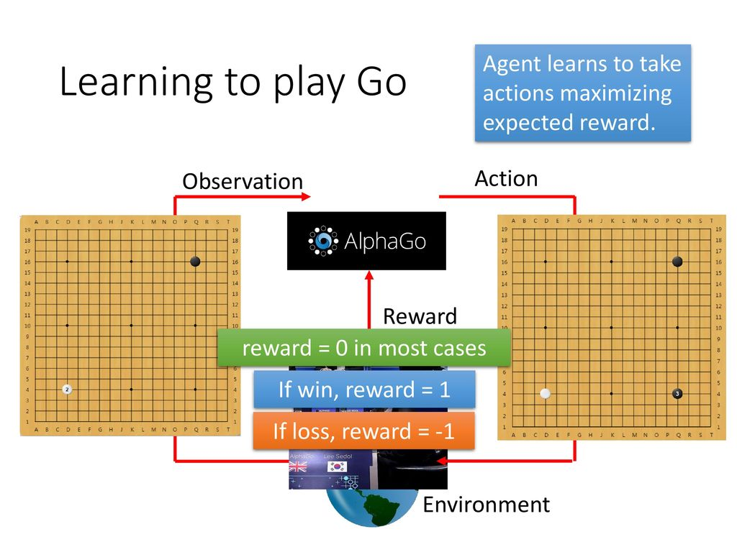
Reinforcement Learning Algorithms

Slide 33
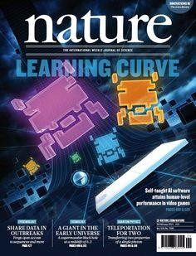
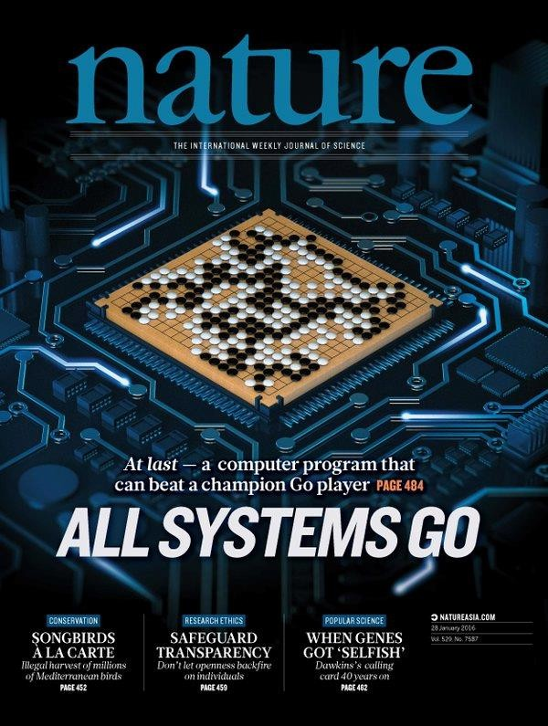
Reinforcement Learning

Slide 34
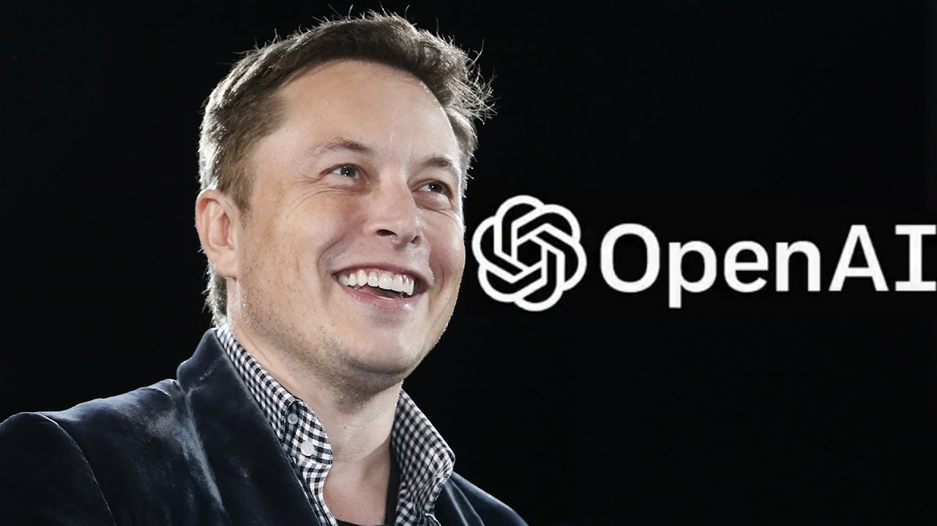
Reinforcement Learning
Notes:
Elon mask telsla, spaceX,…
OPenAI co-founded by elon mask, and very strong on reinforecement learning.

Slide 35
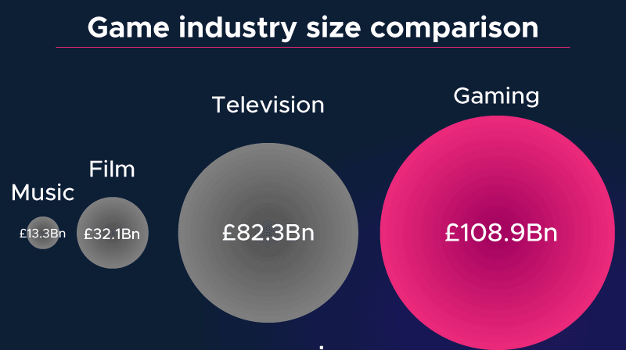
Artificial Intelligence in Gaming: A Comparison
https://www.logikk.com/articles/machine-learning-in-game-development/

Slide 36
Reference
Mofan Tutorial, https://mofanpy.com/tutorials/machine-learning/evolutionary-algorithm/intro/
Hungyi Lee, Machine Learning Tutorial
David Silver, Reinforcement Learning Course, https://www.youtube.com/playlist?list=PLbWDNovNB5mqFBgq7i3MY6Ui4zudcvNFJ

Slide 37
Supervised v.s. EA / RL
Supervised:
Next move:
“5-5”
Next move:
“3-3”
EA / RL
First move …… many moves ……
(Reward)
Win!
Alpha Go is supervised learning + reinforcement learning.

Slide 38
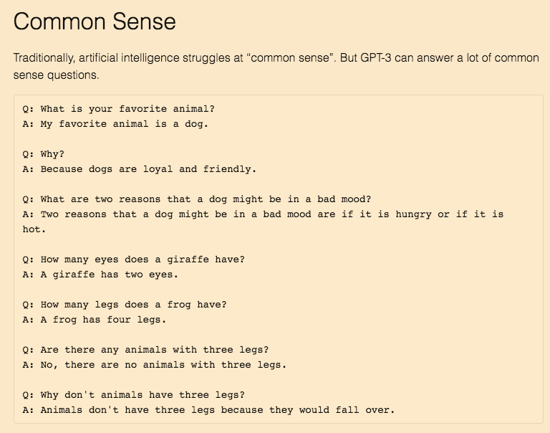
Current AI Status --- GPT-3
https://lacker.io/ai/2020/07/06/giving-gpt-3-a-turing-test.html

